Slide 1
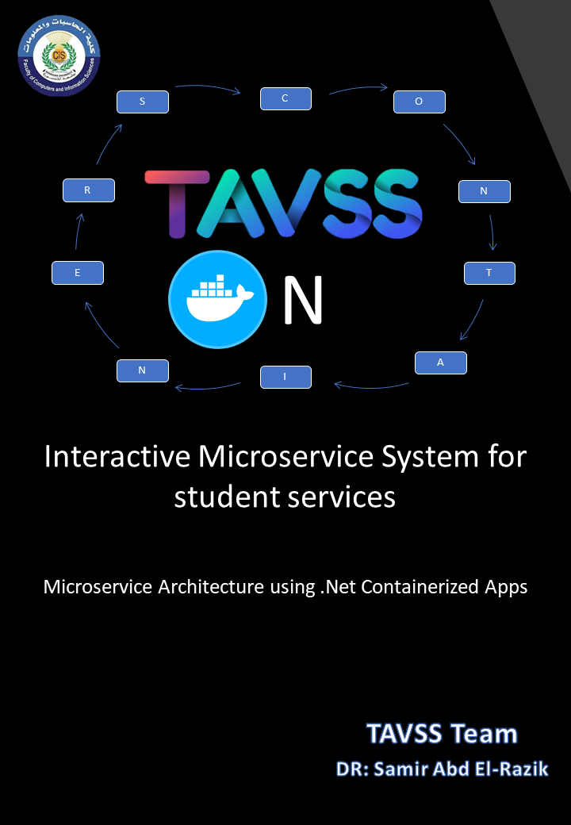

Slide 2
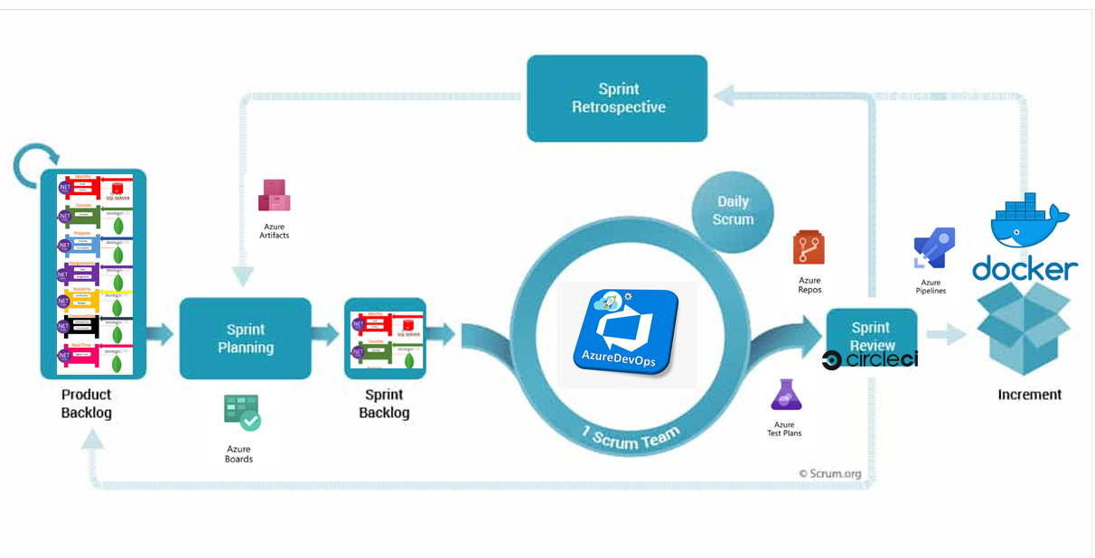
Abstract
The business vision of the project takes the student into a lifecycle of 4 levels (Skills Building – Entertainment - Interaction – Career development) using Internal services integrated with External services.
Applying different design patterns that can integrate any type of services or platforms or programming languages using the Microservices Architecture & patterns.
The Microservice Systems development can be managed using DEVOPS /Scrum framework:
The Scrum/DevOps framework lifecycle begin from the product backlog that contains all the project user stories.
The team begin what sections will start to develop in Sprint planning phase and package them up to the sprint backlog.
Sprint backlog contains what the team develop in their days.
After work the packages will be reviewed using CI/CD tools.
Then operation team can release the sources to increment them on the running environment (docker).
Finishing up the sprint by checking out if there are artifacts or issues to get red of them in next sprints.

Slide 3
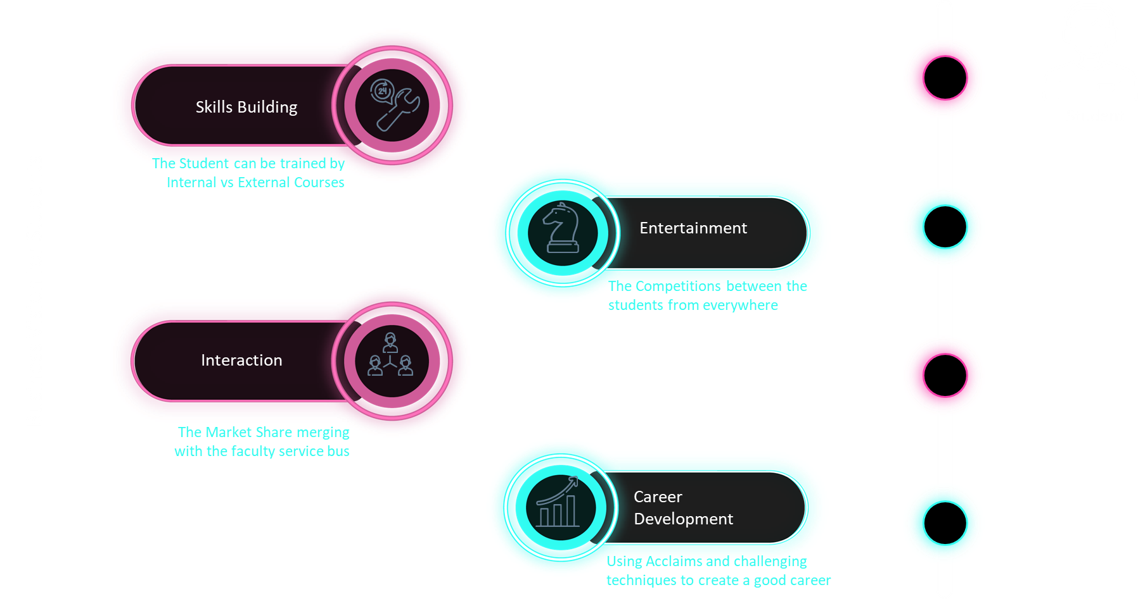
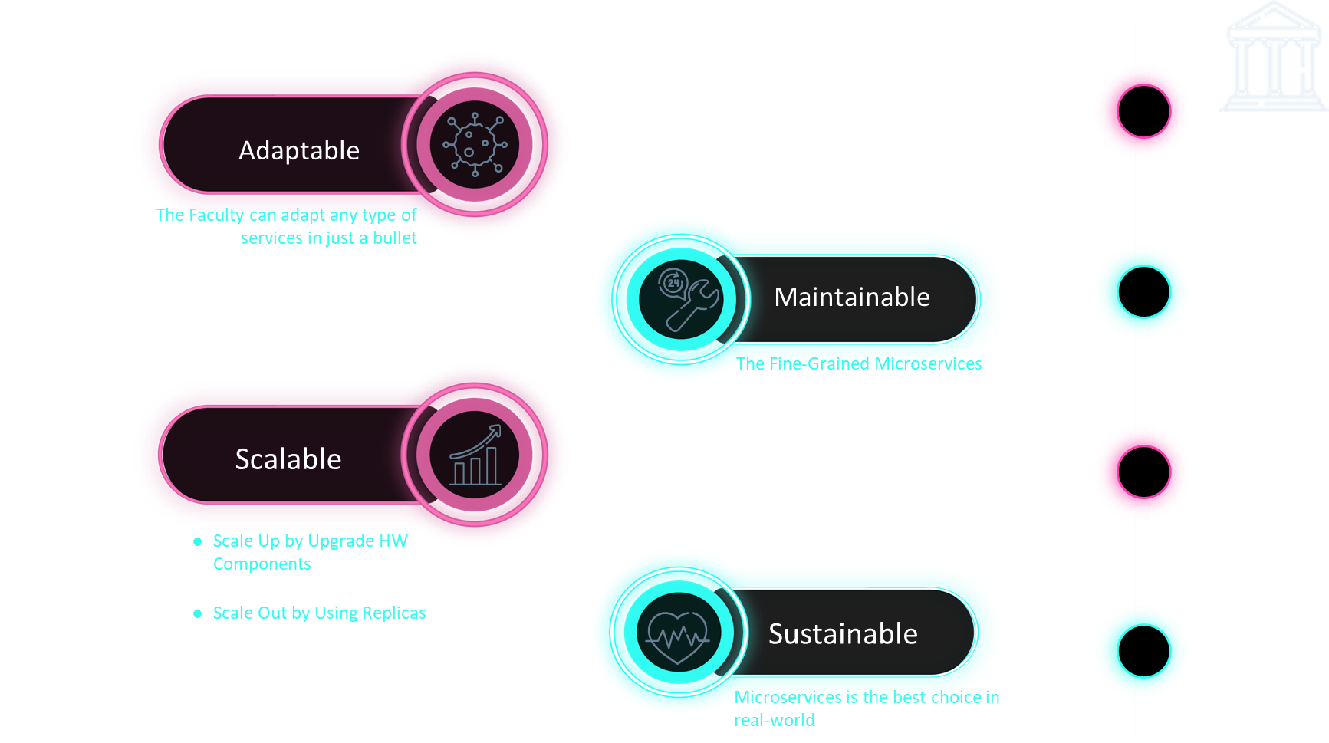
Business Vision
For Students
For Faculty

Slide 4
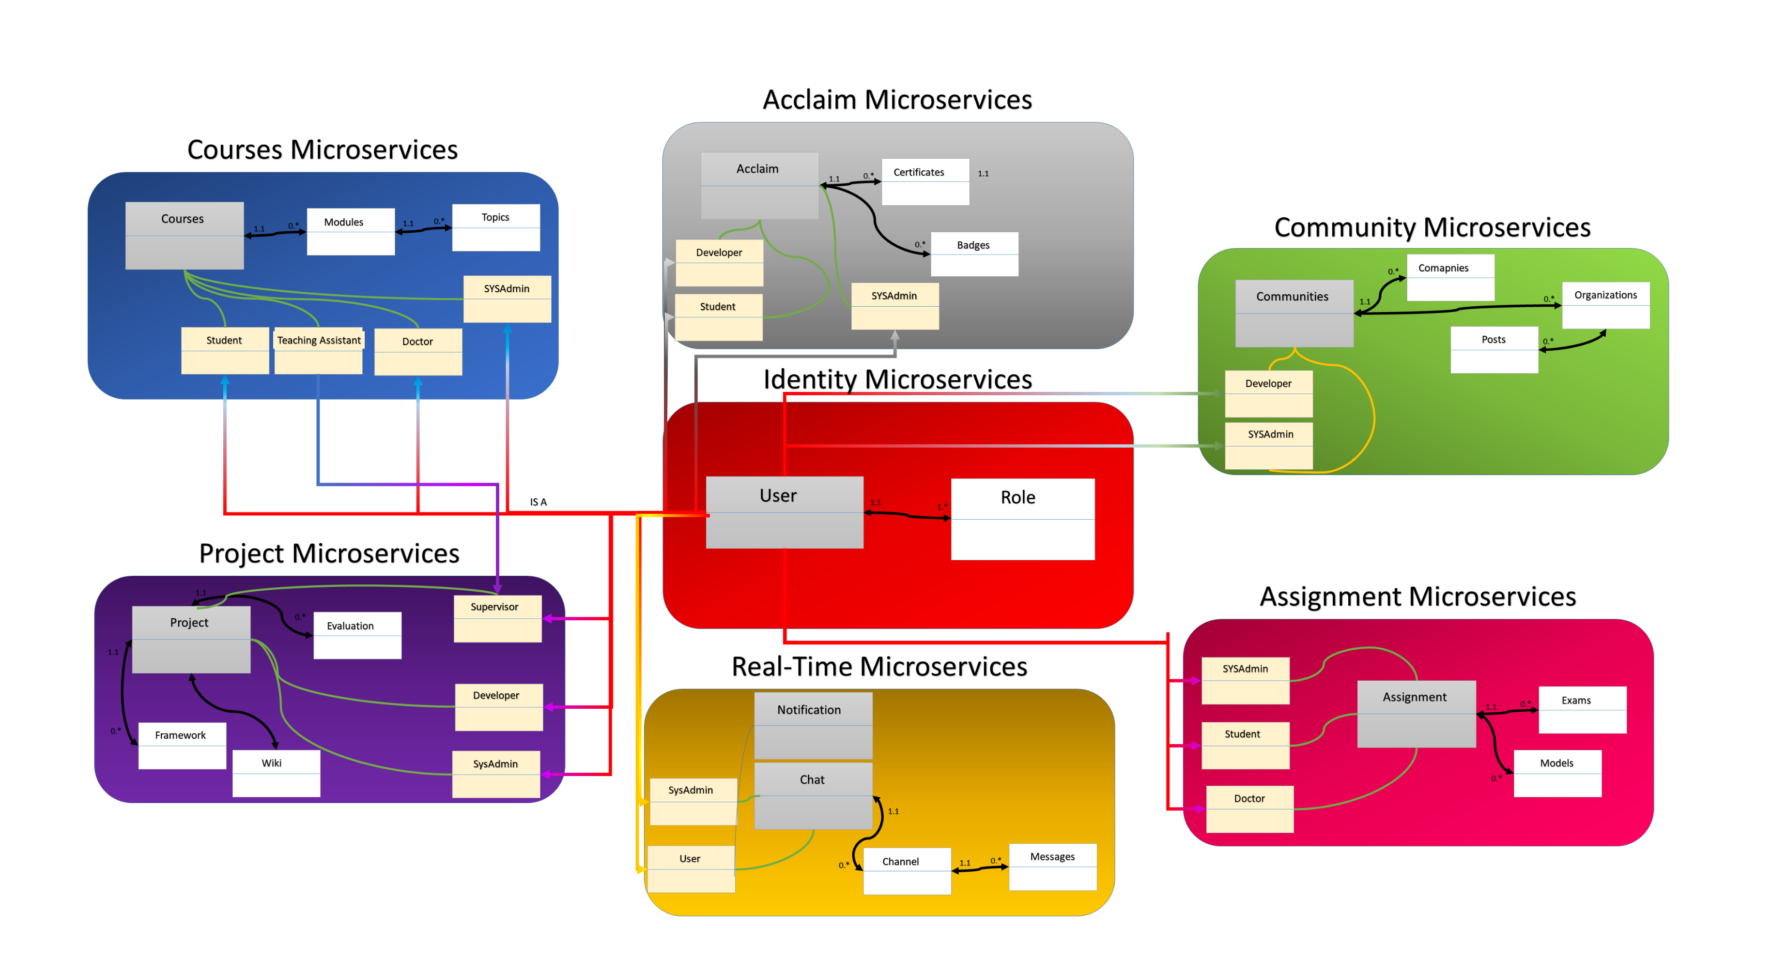
Conceptual Model
the conceptual model explain the interaction of users with the services (Bounded contexts).
First the user is anonymous before the authentication usage by the identity microservices
In every BC there are types of user where they have their permissions and policies like (Course Microservices) have specified roles to sign in like { Admin, Student, Doctor, TA} and every one has its claims.
You can explore it to find roles and the business logic of every one

Slide 5
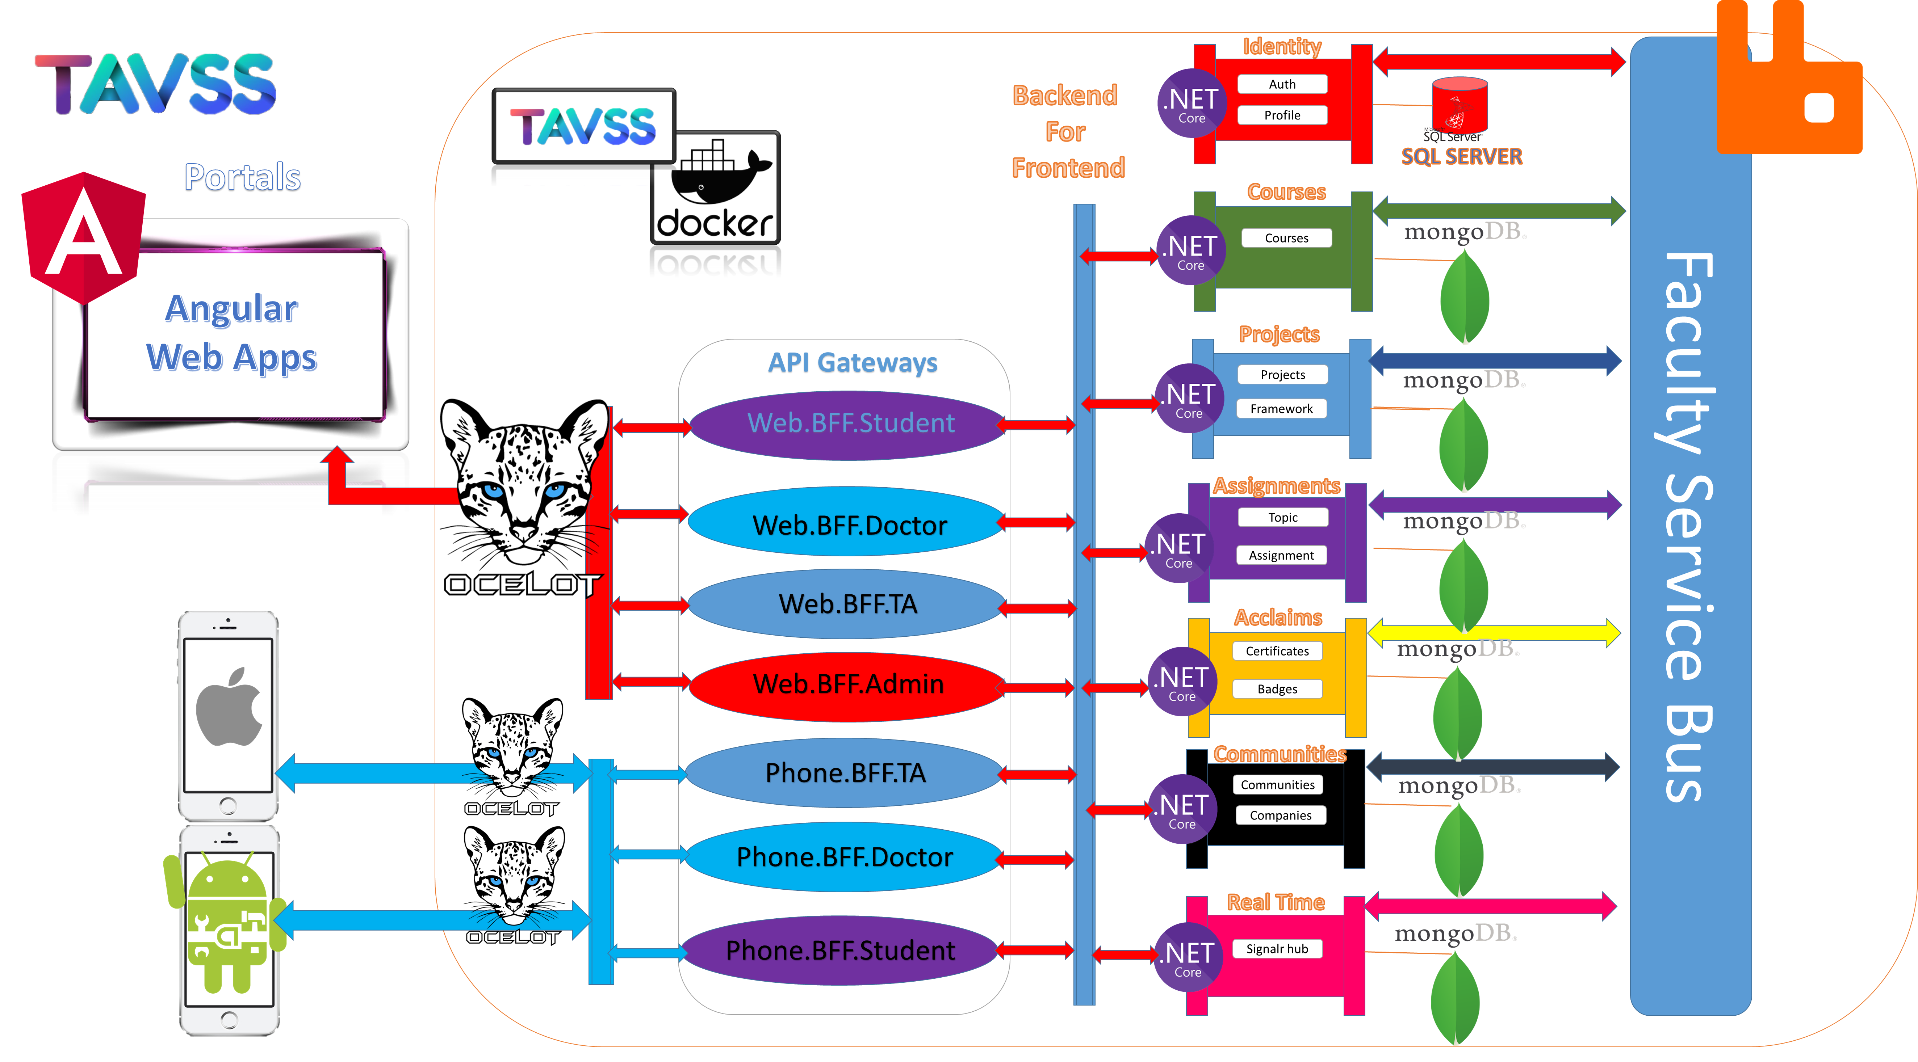
Microservices Architecture
The Architecture contains 7 Microservices domains as illustrated implementing the Single DB per Service Design pattern
All Domains communicate using publisher subscriber design pattern using RappitMQ as the messaging middle ware by AMQP async protocol
Using the BFF and API Gateway design patterns to map the microservices to users and aggregate them as one link to consume them using OCELOT as a package of dotnet core.
Finally frontend apps communicate the REST API links and websockets

Slide 6
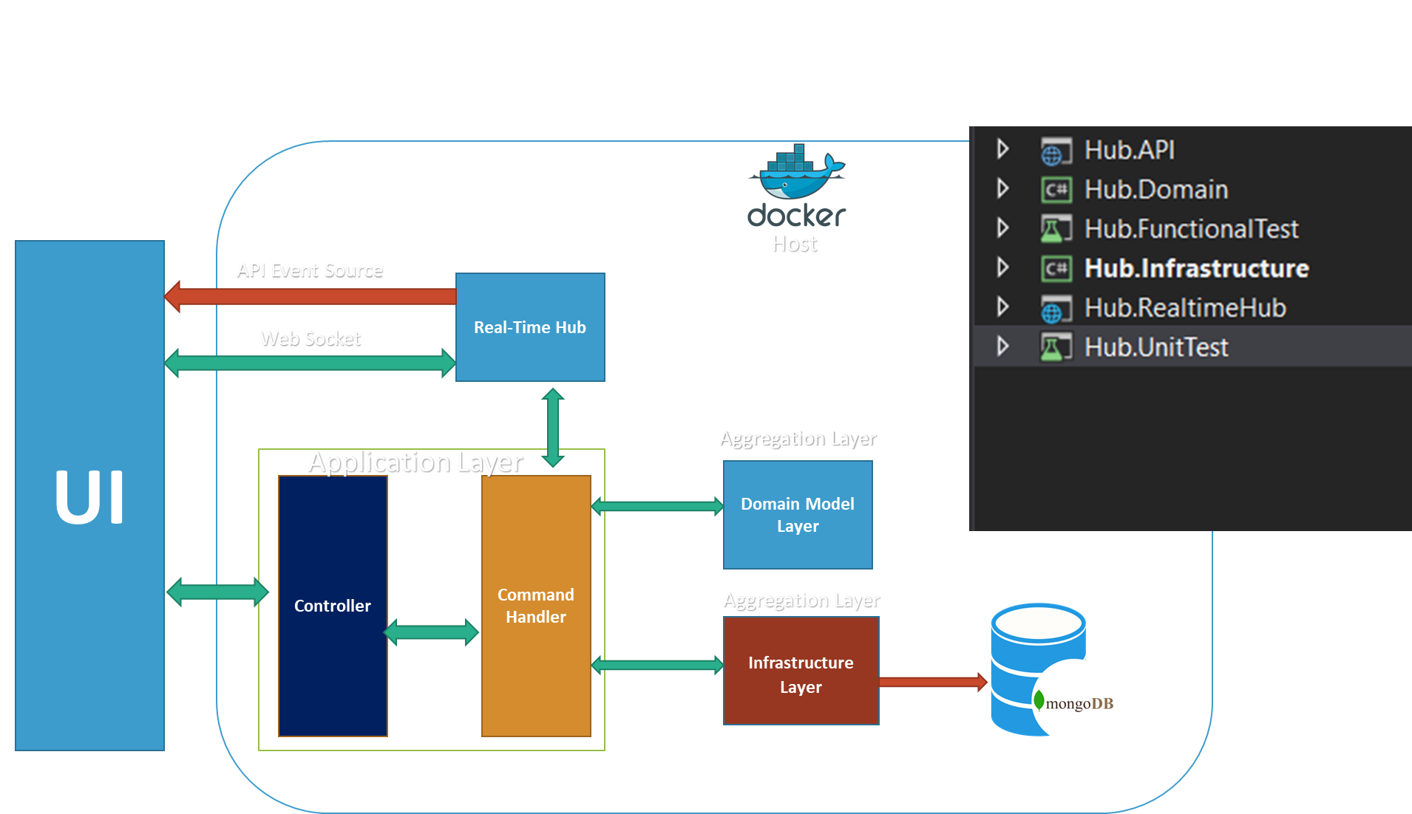
Domain Driven Design using CQRS DP
Dividing the Services into subunits of microservice, each has its roles and responsibilities.
The Domain Model Layer: contain the business logic that is the heart of microservices.
The Infrastructure Layer: is the DB Model Modifier, and the stateful service.
The Application Layer is the API that map users application to use the microservices
The Real-Time App contain the functionalities of how to communicate with UIs in Real-Time consuming using WebSockets and API event source.

Slide 7
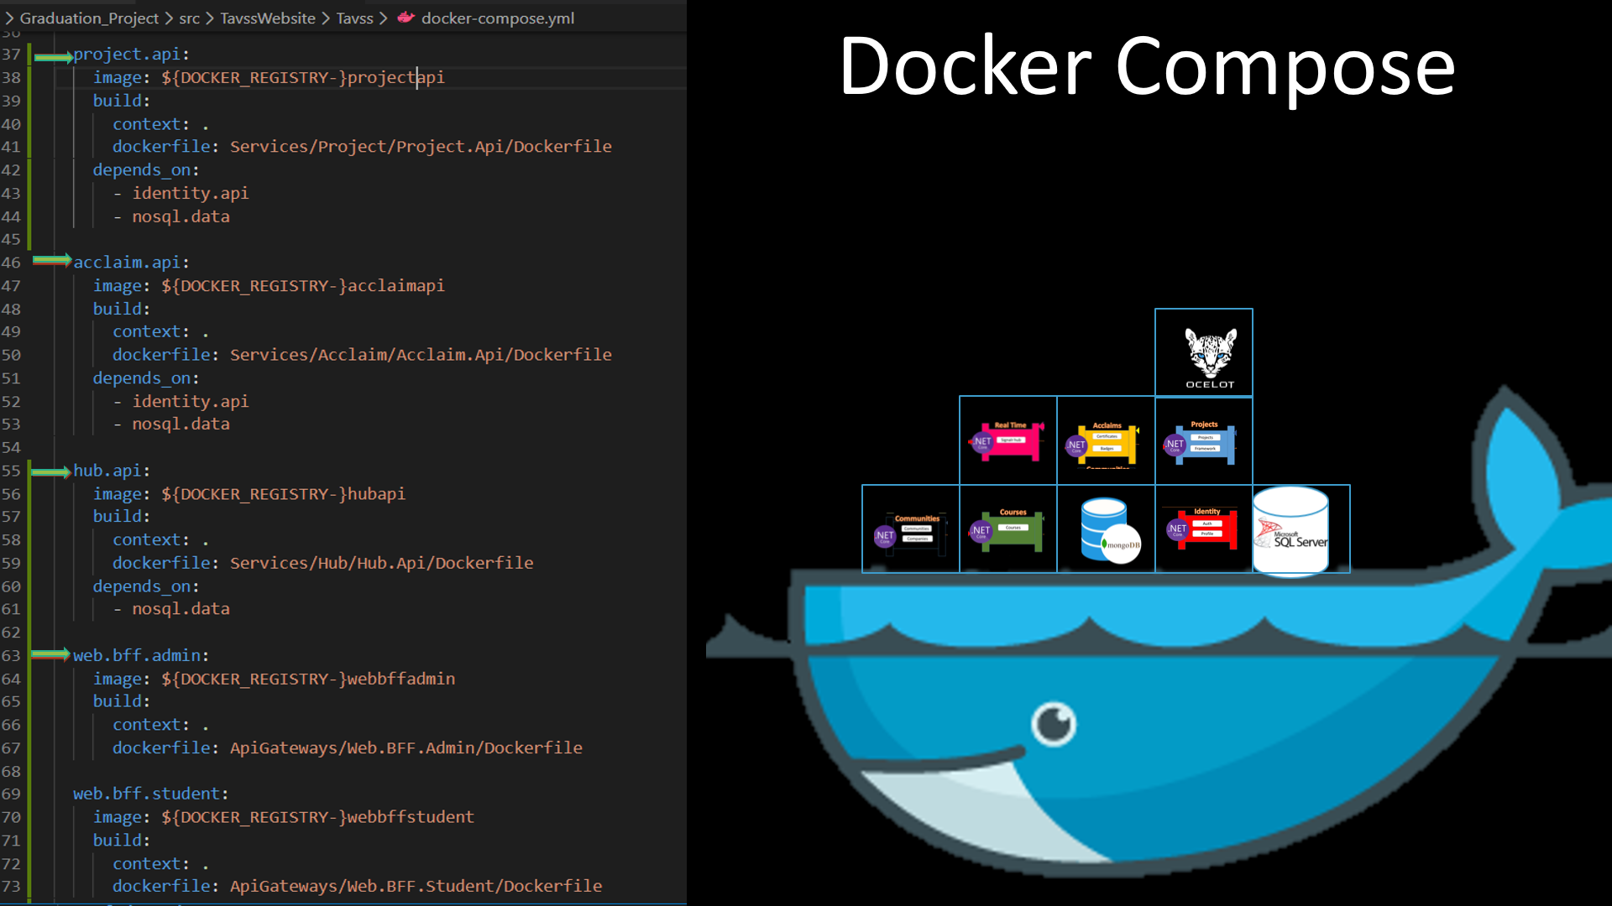
Deploy the Microservices into Docker using Dcompose
Docker is the best automated software to deploy microservices in servers.
Using Docker compose or swarm to compose all microservices to run together independently.
First you must containerized every app inside then create a file for compose all containers together to run on docker.
The file is docker.compose.yml which contain the commands to run and can be overridden by other docker compose files
The compose file specify where are the ports of apps and DBs and the dependencies and the file to compose in environment.

Slide 8
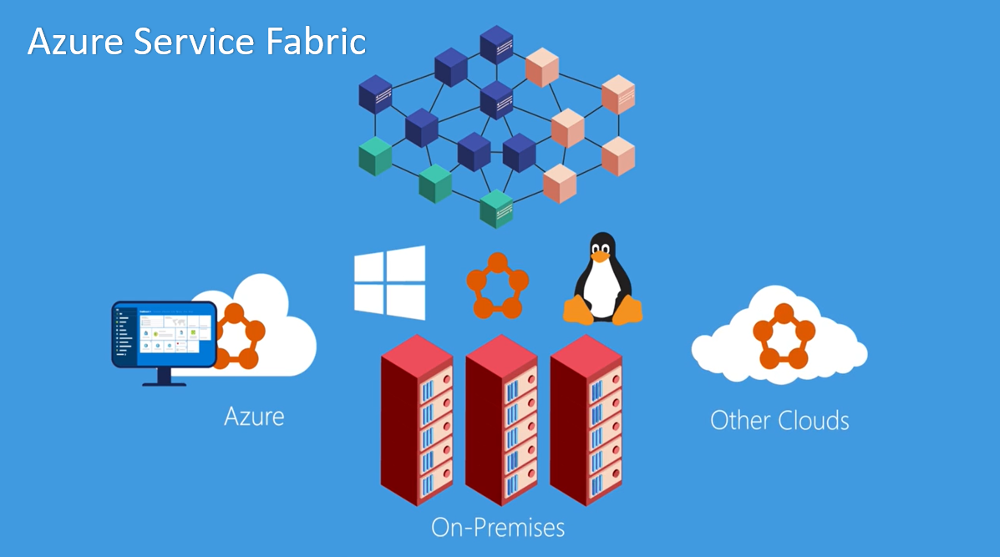
Deploy the Microservices on Microsoft ASF
Azure Service Fabric is a platform application for deployment that automate the process and orchestrate the nodes/servers.
Not only in your On-Premises servers but can be on Azure or other clouds
Using it in Linux or Windows Servers OSs as a mesh of microservices.
The Orchestrator not only deploy the microservices but also manage the failure and scaling of microservices over servers
A good another technology is the Kubernetes that can orchestrate the services

Slide 9
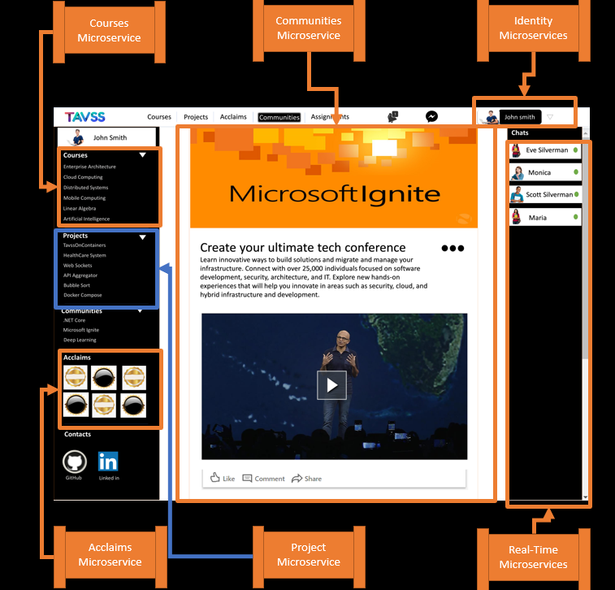
Composite UI consume the Microservices
Consuming the Microservices using single page app (Angular) as a composite UI.
You can find out that UI consume the different backend apps to get a good performance, if a microservice fail just a part fail not all UI

Slide 10
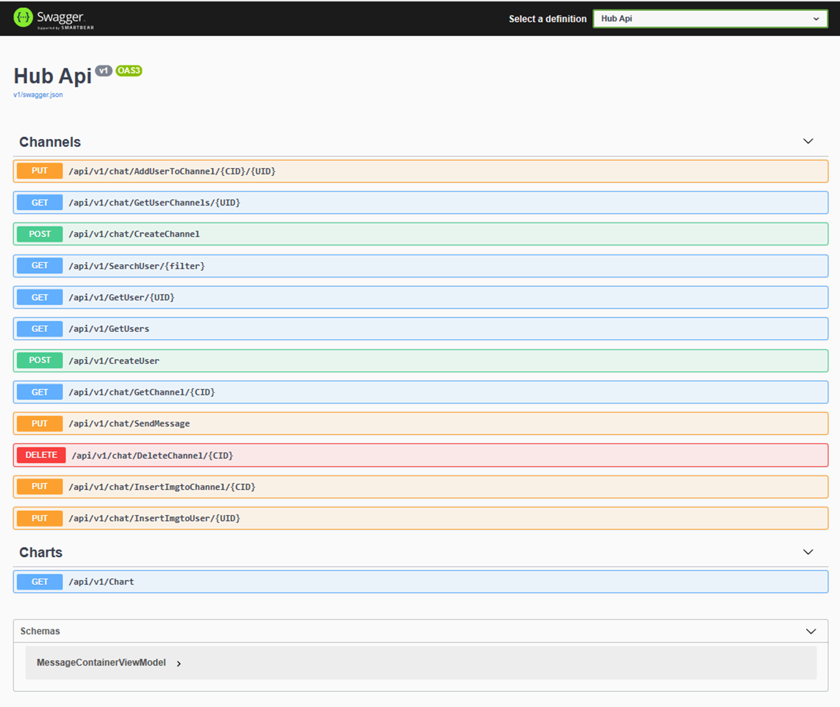
Using The Swagger as the API documentation tool
Swagger API is a good way to document the Restful API to help the development team to check the results of the functions.
It contain a list of API links to {Put, Post, Delete, Put} Restful functions

Slide 11
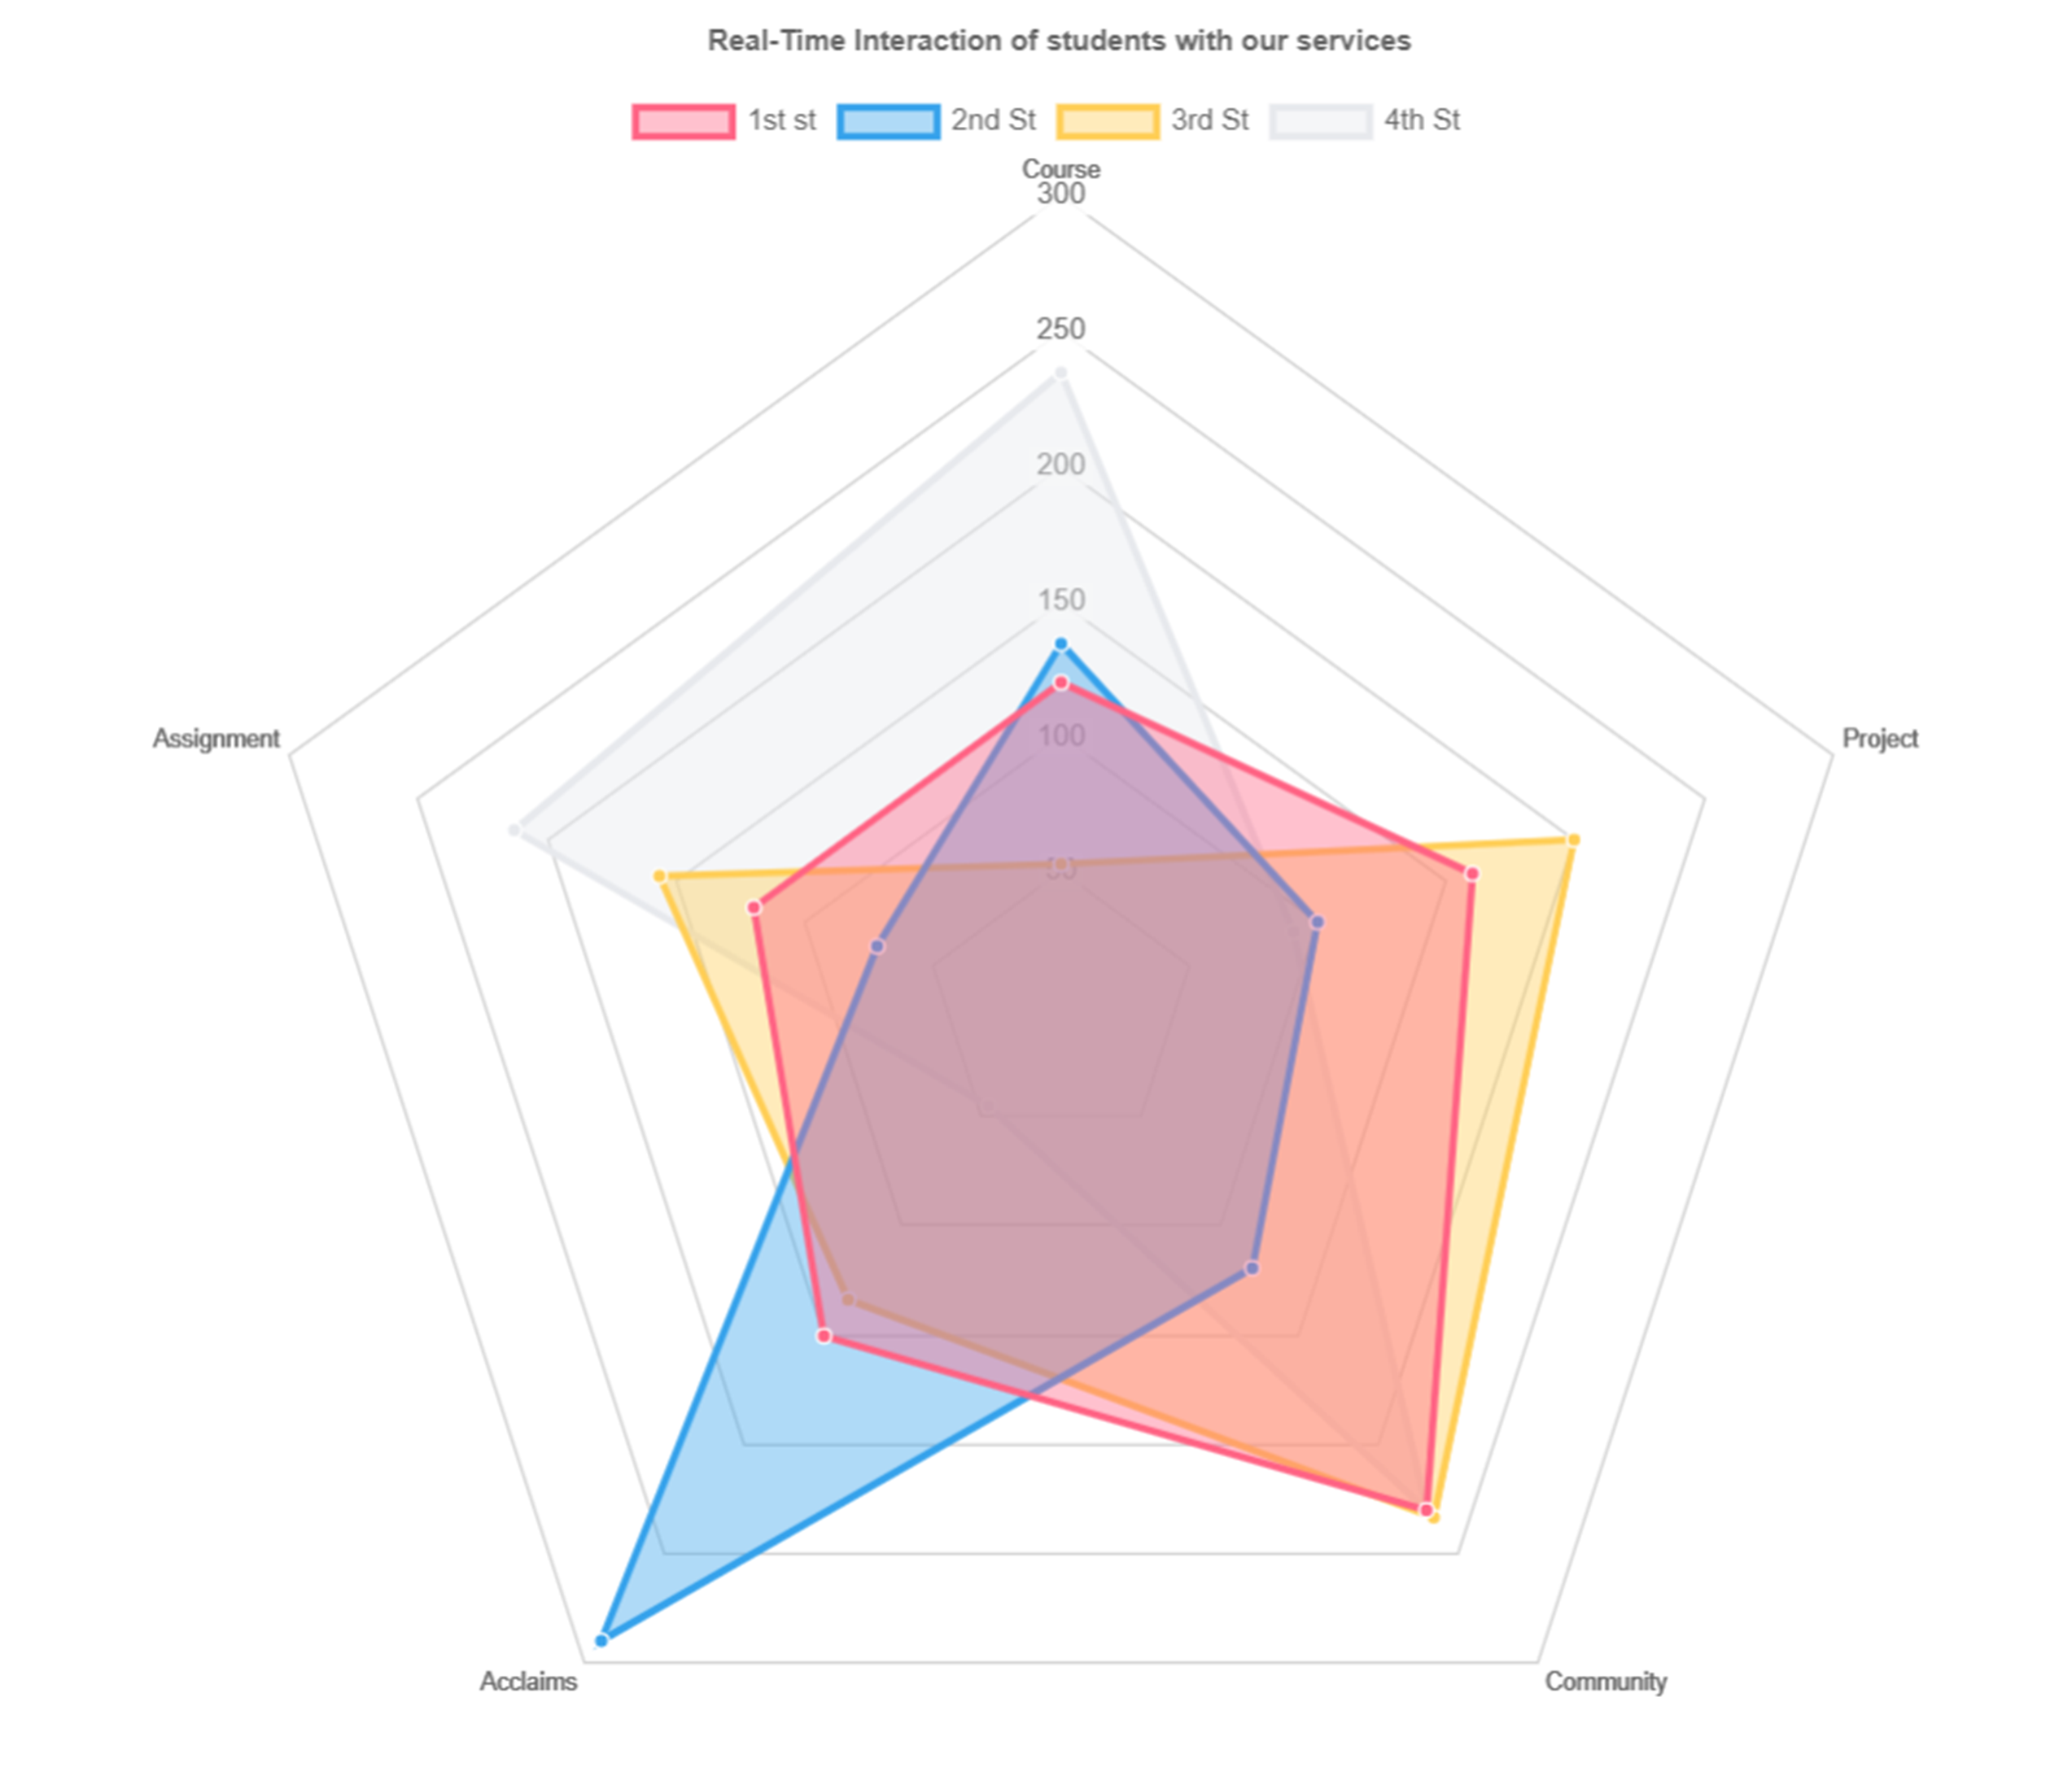
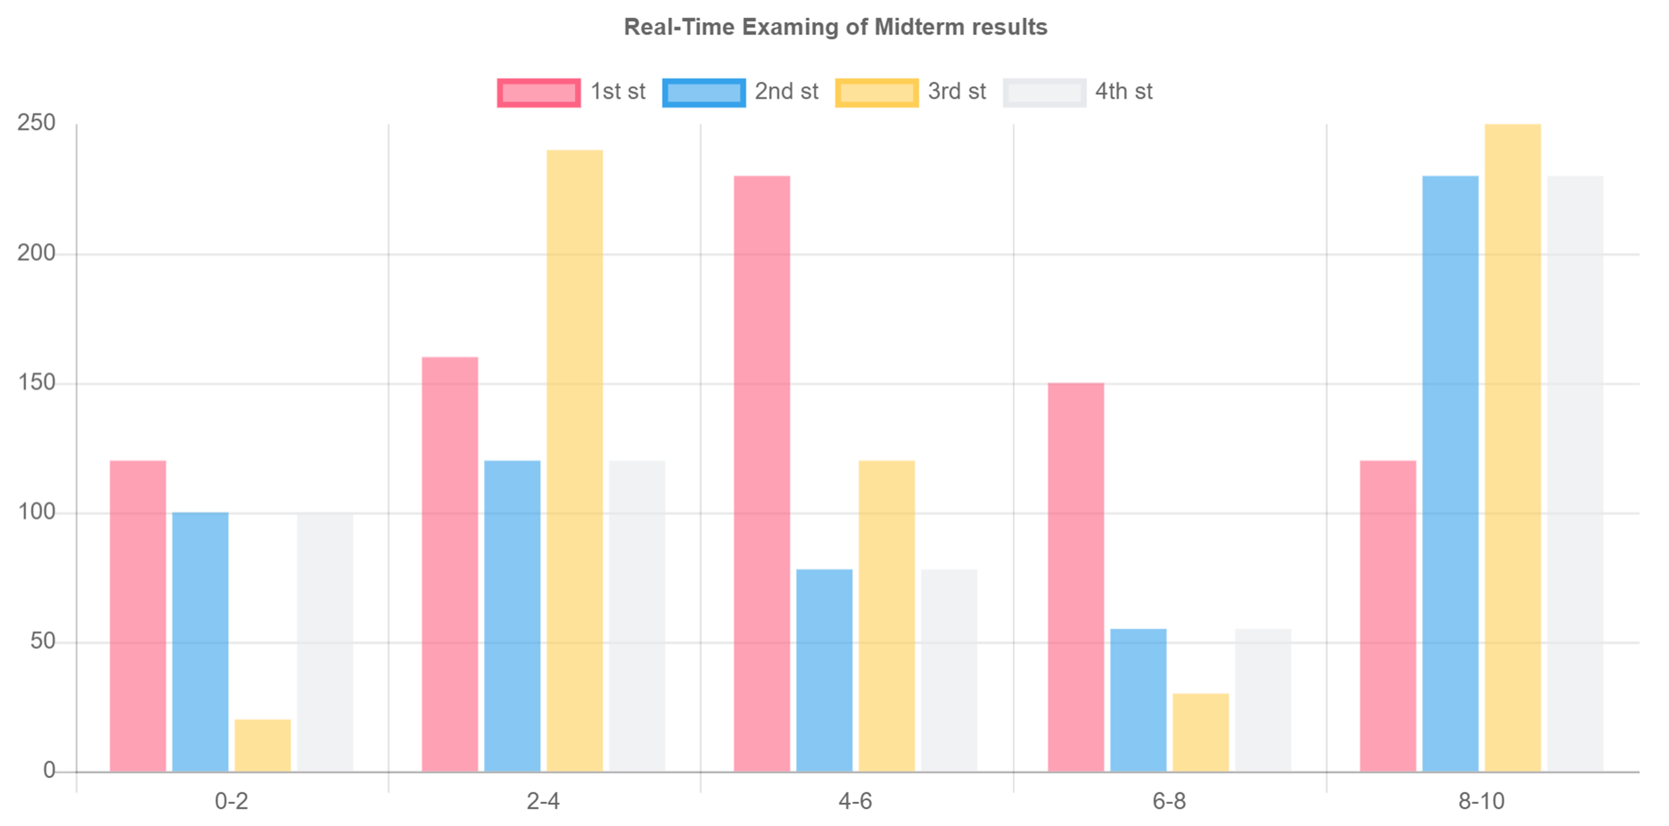
Using The Swagger as the API documentation tool
Using Real-Time Charts for monitoring the interaction of students for every services
Using Real-Time Charts to monitor the E-Exams of students that submit the answers

Slide 12
